Slide 1
Ch05 Combined Data Types
Highlights of the chapter:
5.1 Python Sequential Data Overview
5.2 Basic operations with sequence data
5.3 Lists
5.4 Tuples
5.5 Strings
5.6 Byte Sequences
5.7 Dictionaries (mapping)
5.8 Collections
5.9 Examples of Comprehensive Applications of Data Types

Slide 2
Python Sequential Data Overview
Python's built-in sequence data types
Tuples, lists, strings and bytes.
arrays
Storing data in one or more arrays, accessing and manipulating the elements of the array via index subscripts
Sequence Data Type
Tuples, lists, strings and bytes.

Slide 3
Python's built-in sequence data types
A tuple, also called a fixed-value table, is used to store a table of values whose values are fixed. Example:
Lists, also called tables, are used to store tables whose values are variable. Example:
A string is sequential data that includes a number of characters and supports the basic operations of sequential data. Example:
>>> s1=(1,2,3)
>>> s1 #Output: (1, 2, 3)
>>> s1[2] # Output: 3
>>> s2=[1,2,3]
>>> s2[2]=4
>>> s2 #Output: [1, 2, 4]
>>> s3="Hello, world!"
>>> s3[:5] # The first 5 characters of the string. Output: 'Hello'

Slide 4
Python's built-in sequence data types
Byte sequence data is a sequence of bytes.The pages returned by Python when crawling web pages are usually byte sequences encoded in utf-8. Byte sequences and strings are directly convertible to each other. For example:
>>> s1=b "abc"
>>> s1.decode("utf-8") #Output: 'abc'
>>> s2="Baidu"
>>> s2.encode("utf-8") # Output: b'\xe7\x99\xbe\xe5\xba\xa6'

Slide 5
Basic manipulation of sequence data (1)
Sequence lengths, maxima, minima, summation
len(), max(), min(), get the length of the sequence, the maximum value of the elements in the sequence, the minimum value of the elements in the sequence
sum() to get the sum of the elements in a list or tuple
[Example 5.1] Summing of Sequential Data
>>> t1=(1,2,3,4)
>>> sum(t1) #Output: 10
10
>>> t2=(1,'a',2)
>>> sum(t2) #TypeError: unsupported peraond type(s) for +: 'int' and 'str'
>>> s='1234'
>>> sum(s) #TypeError: unsupported operand type(s) for +: 'int' and 'str'

Slide 6
Basic manipulation of sequence data (2)
Example 5.2: Example of operation on length, maximum value, and minimum value of a sequence
>>> s='abcdefg' >>> len(s) 7 >>> max(s) 'g' >>> min(s) 'a' >>> s2='' >>> len(s2) 0 | >>> t=(10,2,3) >>> len(t) 3 >>> max(t) 10 >>> min(t) 2 >>> t2=() >>> len(t2) 0 | >>> lst=[1,2,9,5,4] >>> len(lst) 5 >>> max(lst) 9 >>> min(lst) 1 >>> lst2=[] >>> len(lst2) 0 | >>> b=b'ABCD' >>> len(b) 4 >>> max(b) 68 >>> min(b) 65 >>> b2=b'' >>> len(b2) 0

Slide 7
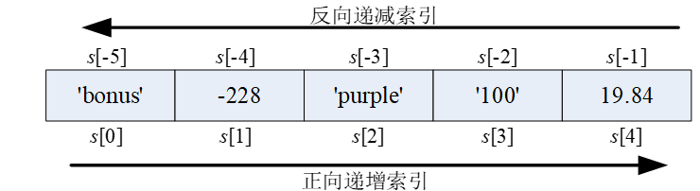
Index access operations for sequences
s[i]········ #Access the element of the series s at index i
[Example 5.3] Index Access Example for Sequence
>>> s='abcdef' >>> s[0] 'a' >>> s[2] 'c' >>> s[-1] 'f' >>> s[-3] 'd' | >>> t=('a','e','i','o','u') >>> t[0] 'a' >>> t[1] 'e' >>> t[-1] 'u' >>> t[-5] 'a' | >>> lst=[1,2,3,4,5] >>> lst[0] 1 >>> lst [1, 2, 3, 4, 5] >>> lst[2]='a' >>> lst[-2]='b' >>> lst [1, 2, 'a', 'b', 5] | >>> b=b'ABCDEF' >>> b[0] 65 >>> b[1] 66 >>> b[-1] 70 >>> b[-2] 69

Slide 8
Slicing operations on sequences
s[i:j] ·· or ·· s[i:j:k]
Example 5.4: Slicing of a Sequence
>>> s='abcdef' >>> s[1:3] 'bc' >>> s[3:10] 'def' >>> s[8:2] '' >>> s[:] 'abcdef' >>> s[:2] 'ab' >>> s[::2] 'ace' >>> s[::-1] 'fedcba' | >>> t=('a','e','i','o','u') >>> t[-2:-1] ('o',) >>> t[-2:] ('o', 'u') >>> t[-99:-5] () >>> t[-99:-3] ('a', 'e') >>> t[::] ('a', 'e', 'i', 'o', 'u') >>> t[1:-1] ('e', 'i', 'o') >>> t[1::2] ('e', 'o') | >>> lst=[1,2,3,4,5] >>> lst[:2] [1, 2] >>> lst[:1]=[] >>> lst [2, 3, 4, 5] >>> lst[:2] [2, 3] >>> lst[:2]='a' >>> lst[1:]='b' >>> lst ['a', 'b'] >>> del lst[:1] >>> lst ['b'] | >>> b=b'ABCDEF' >>> b[2:2] b'' >>> b[0:1] b'A' >>> b[1:2] b'B' >>> b[2:2] b'' >>> b[-1:] b'F' >>> b[-2:-1] b'E' >>> b[0:len(b)] b 'ABCDEF'

Slide 9
Sequence concatenation and repetition operations
s1 + s2 or s * n or n * s
Example 5.5] Example of concatenation and repetition of sequences
>>> s1='abc' >>> s2='xyz' >>> s1+s2 'abcxyz' >>> s1*3 'abcabcabc' >>> s1 += s2 >>> s1 'abcxyz' >>> s2 *= 2 >>> s2 'xyzxyz' | >>> t1=(1,2) >>> t2=('a','b') >>> t1+t2 (1, 2, 'a', 'b') >>> t1*2 (1, 2, 1, 2) >>> t1 += t2 >>> t1 (1, 2, 'a', 'b') >>> t2 *= 2 >>> t2 ('a', 'b', 'a', 'b') | >>> lst1=[1,2] >>> lst2=['a','b'] >>> lst1+ lst2 [1, 2, 'a', 'b'] >>> 2 * lst2 ['a', 'b', 'a', 'b'] >>> lst1 += lst2 >>> lst1 [1, 2, 'a', 'b'] >>> lst2 *=2 >>> lst2 ['a', 'b', 'a', 'b'] | >>> b1=b'ABC' >>> b2=b'XYZ' >>> b1+b2 b 'ABCXYZ' >>> b1*3 b 'ABCABCABC' >>> b1+=b2 >>> b1 b 'ABCXYZ' >>> b2*=2 >>> b2 b 'XYZXYZ'

Slide 10
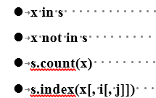
Membership operations on sequences
# if true, itindicates他和eexistence
# if true, it indicates not existence
# return the number of times x appears in s
# return the subscript of the first occurrence of x in s
[Example 5.6] Example of Judgment of Existence of Elements in a Sequence
>>> s='Good, better, best!' >>> 'o' in s True >>> 'g' not in s True >>> s.count('e') 3 >>> s.index('e', 10) 10 | >>> t=('r', 'g', 'b') >>> 'r' in t True >>> 'y' not in t True >>> t.count('r') 1 >>> t.index('g') 1 | >>> lst=[1,2,3,2,1] >>> 1 in lst True >>> 2 not in lst False >>> lst.count(1) 2 >>> lst.index(3) 2 | >>> b=b'Oh, Jesus!' >>> b'O' in b True >>> b'o' not in b True >>> b.count(b's') 2 >>> b.index(b's') 6

Slide 11
Comparison operations on sequences
[Example 5.7] Comparison of Sequences
>>> s1='abc' >>> s2='abc' >>> s3='abcd' >>> s4='cba' >>> s1 > s4 False >>> s2 <= s3 True >>> s1 == s2 True >>> s1 ! = s3 True >>> 'a' > 'A' True >>> 'a' >= '' True | >>> t1=(1,2) >>> t2=(1,2) >>> t3=(1,2,3) >>> t4=(2,1) >>> t1<t4 True >>> t1 <= t2 True >>> t1 == t3 False >>> t1 ! = t2 False >>> t1 >= t3 False >>> t4 > t3 True | >>> s1=['a','b'] >>> s2=['a','b'] >>> s3=['a','b','c'] >>> s4=['c','b','a'] >>> s1<s2 False >>> s1<=s2 True >>> s1==s2 True >>> s1!=s3 True >>> s1>=s3 False >>> s4>s3 True | >>> b1=b'abc' >>> b2=b'abc' >>> b3=b'abcd' >>> b4=b'ABCD' >>> b1<b2 False >>> b1<=b2 True >>> b1==b2 True >>> b1>=b3 False >>> b3!=b4 True >>> b4>b3 False

Slide 12
Sorting operations on sequences
sorted(iterable, key=None, reverse=False) ······ # Returns a sorted list of the series
[Example 5.8] Sorting Operation Example of Sequence
>>> s1='axd' >>> sorted(s1) ['a', 'd', 'x'] >>> s2=(1,4,2) | >>> sorted(s2) [1, 2, 4] >>> sorted(s2,reverse=True) [4, 2, 1] | >>> s3='abAC' >>> sorted(s3, key=str.lower) ['a', 'A', 'b', 'C']

Slide 13
Built-in functions all() and any()
all(iterable) #Returns True if all values of the sequence are True; otherwise, returns False
any(iterable) # if any value of the sequence is True, return True; otherwise, return False
>>> any((1, 2, 0)) True | >>> all([1, 2, 0]) False

Slide 14
sequence splitting
The number of variables is equal to the length of the sequence
Unequal number of variables and sequence length
variable 1, variable 2, …, variable n = sequence or iterable object
You can use tuple variable * to assign multiple values as a tuple to a tuple variable
>>> first, *middles, last = range(10)
>>> middles #Output: [1, 2, 3, 4, 5, 6, 7, 8]
>>> first, second, third, *lasts = range(10)
>>> lasts # Output: [3, 4, 5, 6, 7, 8, 9]
>>> *firsts, last3, last2, last1 = range(10)
>>> firsts #Output: [0, 1, 2, 3, 4, 5, 6]
>>> first, *middles, last = sorted([70, 85, 89, 88, 86, 95, 89])
#remove highest and lowest scores
>>> sum(middles)/len(middles) # Calculate the average after removing the highest and lowest scores. Output: 87.4

Slide 15
sequence splitting
Use of temporary variables_
>>> _, b, _ = (1, 2, 3)
>>> b # Output: 2
>>> record = ('Zhangsan', 'szhang@abc.com', '021-62232333', '13912349876')
>>> name, _, *phones = record
>>> phones #Output: ['021-62232333', '13912349876']

Slide 16
listings
Definition of a list: a data structure with an ordered set of items
It can also be created by creating a list object
Example 5.9] Creating a List Instance Object Using List Literals
Example 5.10] Creating a List Instance Object Using the List Object
list() # Creates a empty list
list(iterable) # Creates a list of items that are elements of the enumerable object iterable.
>>> a1=[]
>>> a2=[1]
>>> a3=["a", "b", "c"]
>>> print(a1, a2, a3) #Output: [] [1] ['a', 'b', 'c']
>>> a1=list()
>>> a2=list("abc")
>>> a3=list(range(3))
>>> print(a1, a2, a3) #Output: [] ['a', 'b', 'c'] [0, 1, 2]

Slide 17
List Parsing Expressions
[expr for i₁ in sequence 1 … for i_{N} in sequence N] # Iterate over the contents of the sequence and count the generated list.
[expr for i₁ in sequence 1 … for i_{N} in sequence N if cond_expr] # Iterate by condition and count to generate list
[Example 5.11] Example of a list parsing expression.
>>> [i**2 for i in range(10)] #Squared values
[0, 1, 4, 9, 16, 25, 36, 49, 64, 81]
>>> [(i,i**2) for i in range(10)] #number, square value
[(0, 0), (1, 1), (2, 4), (3, 9), (4, 16), (5, 25), (6, 36), (7, 49), (8, 64), (9, 81)]
>>> [i for i in range(10) if i%2==0] #Take an even number.
[0, 2, 4, 6, 8]
>>> [(x, y, x*y) for x in range(1, 4) for y in range(1, 4) if x>=y] #dual loop
[(1, 1, 1), (2, 1, 2), (2, 2, 4), (3, 1, 3), (3, 2, 6), (3, 3, 9)]

Slide 18
Sequential operations on lists
Index access, slicing, joining, duplication, membership, comparison, and list length, maximum, minimum, and so on.
Example 5.12] Example of Sequential Operations on Lists
>>> s=[1,2,3,4,5,6] >>> s[1]='a' >>> s [1, 'a', 3, 4, 5, 6] >>> s[2]=[] >>> s | [1, 'a', [], 4, 5, 6] >>> del s[3] >>> s [1, 'a', [], 5, 6] >>> s[:2] [1, 'a'] | >>> s[2:3]=[] >>> s [1, 'a', 5, 6] >>> s[:1]=[] >>> s ['a', 5, 6] | >>> s[:2]='b' >>> s ['b', 6] >>> del s[:1] >>> s [6]

Slide 19
Methods of the list object
Assume that the examples in the table are based on a=[1,3,2]
methodologies | clarification | typical example
s.append(x) | Append object x to the end of list s | s.append('a') #s= [1, 3, 2, 'a'] s.append([1,2]) #s= [1, 3, 2, 'a', [1, 2]]
s.clear() | Delete all elements. Equivalent to del s[:] | s.clear() #s= []
s.copy() | copy list | s1=s.copy() #s1= s=[1,3,2] id(s),id(s1) #( 3143376592008, 3143376591496)
s.extend(t) | Append the sequence t to the end of s | s.extend([4]) #s= [1, 3, 2, 4] s.extend('ab') #s= [1, 3, 2, 4, 'a', 'b']
s.insert(i, x) | Insert the object x at position i of the subscript | s.insert(1,4) #s= [1, 4, 3, 2] s.insert(8,5) #s= [1, 4, 3, 2, 5]
s.pop([i]) | Returns and removes the object at position i of the subscript, or the last object if i is omitted. If the subscript is exceeded, an IndexError will result. | s.pop() # output 2. s= [1, 3] s.pop(0) # output 1. s=[3]
s.remove(x) | Removes the first occurrence of x in the list. if the object does not exist, a ValueError will result. | s.remove(1) #s= [3, 2] s.remove('a') #ValueError: list.remove(x): x not in list
s.reverse() | list inversion | s.reverse() #s=[2, 3, 1]
s.sort() | List Sorting | s.sort() #s=[1, 2, 3]

Slide 20
tuple
A set of ordered sequences containing zero or more object references
Definition of the tuple
Tuples can also be created by creating tuple objects
[Example 5.13] Creating a Tuple Instance Object Using Tuple Literals
x1, [x2, …, xn] or (x1, [x2, …, xn])
tuple(): create a empty tuple
tuple(iterable): create a tuple containing the elements of the enumerable object iterable.
>>> t1=1,2,3 >>> t2=() >>> t3=1 >>> t4=(1) >>> t5='a','b','c' | >>> t6=2.0, >>> print(t1) (1, 2, 3) >>> print(t2) () | >>> print(t3) 1 >>> print(t4) 1 | >>> print(t5) ('a', 'b', 'c') >>> print(t6) (2.0,)
Note that when there is only one item in the tuple, the comma after it cannot be omitted. This is because the Python interpreter interprets (x1) as x1, e.g. (1) as the integer 1, and (1,) as the tuple

Slide 21
Creating tuple instance objects using tuple objects
[Example 5.14] Creating a Tuple Instance Object Using a Tuple Object
>>> t1=tuple()
>>> t2=tuple("abc")
>>> t3=tuple([1,2,3])
>>> t4=tuple(range(3))
>>> print(t1,t2,t3,t4) #Output: () ('a', 'b', 'c') (1, 2, 3) (0, 1, 2)

Slide 22
Sequential operations on tuples
Index access, slice operations, join operations, repeat operations, membership operations, comparison operations, and finding tuple lengths, maxima, minima, etc.
[Example 5.15] Example of Sequential Operations on Tuples
>>> t1=(1,2,3,4,5,6,7,8,9,10)
>>> len(t1) #Output: 10
>>> max(t1) #Output: 10
>>> sum(t1) #Output: 55

Slide 23
str data type (string)
Python does not have a separate character datatype; a character is a string of length 1.
Python's built-in datatype str for string processing
The value of the str object is a family of characters
The str object (string) is immutable.
The contents enclosed in single or double quotes are string literals

Slide 24
Python String Literals
[Example 5.16] String Literals Example
Single quotes (' '). A string contained within single quotes, which can contain double quotes.
Double quote (" "). A string contained in double quotes, which can contain single quotes
Triple single quotes (''' '''). String contained in triple single quotes which can span lines.
Triple double quotes (""" """). String contained in triple double quotes that can span lines.
>>> 'abc' #Output: 'abc'
'abc'
>>> "Hello" # Output: 'Hello'
'Hello'
>>> type("python") #Output: <class 'str'>
<class 'str'>
>>> 'Blue' 'Sky' #Output: 'BlueSky'
'BlueSky'

Slide 25
string encoding
Python 3 characters default to 16-bit Unicode encoding
use the built-in function ord() can be converted to the corresponding Unicode code; use the built-in function chr() can be converted to the corresponding decimal number of characters
>>> ord('A') #Output: 65
65
>>> chr(65) #Output: 'A'
'A'
>>> ord('Zhang') #Output: 24352
24352
>>> chr(24352) #Output: 'Zhang'
'Zhang'

Slide 26
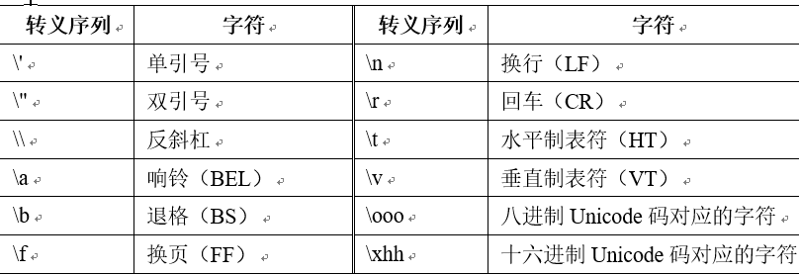
escape character

Slide 27
escape character
[Example 5.17] Escape String Example
>>> s = 'a\tb\tc\\\td'
>>> s # Output: 'a\tb\tc\\\\td'
>>> print(s) #Output: a b c\td
>>> '\101' # Output: 'A'
>>> '\x41' # Output: 'A'
>>> s = r'change \t line\t character\n'
>>> s #Output: 'Change \\t line \\t character \\n'
>>> print(s) #Output: change \t line \t symbol \n

Slide 28

str object
Creates an instance of an object of type str
[Example 5.18] Example of an application that uses str() to create a string object (strToint.py): summing the digits in each digit of a given integer
str(object='') # Create str object, defaults to empty string
intN=123456 # given an integer
total=0 #Accumulate and assign initial value to total.
for s in str(intN): # Convert the integer to a string, iterating over the string sequence using the for statement
total += int(s) #Convert characters to integers to achieve digit accumulation across digits
print(total) #Output the sum of the digits in each digit of the given integer.

Slide 29
str object properties and methods
The methods of the str object are called in two ways: the methods of the string object and the methods of the str class.
Example 5.20: Example of str object method
>>> s='abc'
>>> s.upper() # Method for string object s. Output: 'ABC'
'ABC'
>>> str.upper(s) #str class method with string s as argument. Output: 'ABC'
'ABC'

Slide 30
Type judgment of strings
str.isalnum() # whether it is all letters or numbers
str.isalpha() #Is all alpha
str.isdecimal() # whether to include only decimal numeric characters
str.isdigit() #Is it all digits (0~9)
str.isidentifier() # whether it is a legal identifier or not
str.islower() #Is it all lowercase?
str.isupper() #Is it all uppercase?
str.isnumeric() # whether it contains only numeric characters
str.isprintable() # whether it contains only printable words
str.isspace() # whether it contains only blank characters
str.istitle() #Is it a title, i.e. the first letter of each word is capitalized
[Example] String Type Determination Example
>>> s1='yellow ribbon' >>> s2='Pascal Case' >>> s3='123' >>> s4='iPhone 7' | >>> s1.islower() True >>> s2.isupper() False | >>> s4.isalnum() True >>> s3.isnumeric() True | >>> s1.isdigit() False >>> s2.istitle() True

Slide 31
String Case Conversion
str.capitalize() #convert to first letter uppercase, rest lowercase
str.lower() #convert to lowercase
str.upper() #convert to uppercase
str.swapcase() # case swap
str.title() #convert to initial capitalization for each word
str.casefold() #convert to case-independent string comparison format string
Example] String Case Conversion Example
>>> s1='red car' >>> s2='Pascal Case' >>> s3='python3.7' >>> s4='iPhoneX' | >>> s1.capitalize() 'Red car' >>> s2.lower() 'pascal case' | >>> s3.upper() 'PYTHON3.7 >>> s2.swapcase() 'pASCAL cASE' | >>> s1.title() 'Red Car' >>> s4.casefold() ' iphonex'

Slide 32
String padding, whitespace and alignment
str.strip([chars]) # remove spaces on both sides, you can also specify the list of characters to remove
str.lstrip([chars]) #remove the left space, you can also specify a list of characters to remove
str.rstrip([chars]) # remove right-hand spaces, also specify a list of characters to be removed
str.zfill(width) #left fill, use 0 to fill to width length
str.center(width[, fillchar]) #fill both sides, use fillchar (default space) to fill to width length
str.ljust(width[, fillchar]) #String left-alignment adjustment, right side is filled to width length using the fillchar character (default space)
str.rjust(width[, fillchar]) #String right-justification adjustment, the left side is filled to the length of width using the fill character fillchar (default space)
str.expandtabs([tabsize]) #Expand tabs in a string to a number of spaces, tabsize defaults to 8
Example] String Filling, Whitespace and Alignment Example
>>> s1='123' >>> s2=' 123 ' >>> len(s2) 6 | >>> s2.strip() '123' >>> s2.lstrip() '123 ' | >>> s1.zfill(5) '00123' >>> s1.center(5, ' ') ' 123 ' | >>> s1.ljust(5) '123 ' >>> s1.rjust(5, '0') '00123'

Slide 33
Test, find and replace strings
str.startswith(prefix[, start[, end]]) #whether or not it starts with a prefix
str.endswith(suffix[, start[, end]]) #whether or not it ends in suffix
str.count(sub[, start[, end]]) #returns the number of occurrences of the specified string
str.index(sub[, start[, end]]) #search for the specified string, return the subscript, none results in ValueError
str.rindex(sub[, start[, end]]) # search the specified string from the right, return subscripts
str.find(sub[, start[, end]]) #search for the specified string and return the subscript, or -1 if none is present
str.rfind(sub[, start[, end]]) #search the specified string from the right, return the subscript, or -1 if there isn't one
str.replace(old, new[, count]) #replace old with new, optional count is the number of replacements
Example] String Test, Find and Replace Example
>>> s1="abABabCD" >>> s1.startswith("AB") False >>> s1.startswith("AB",2) True | >>> s1.endswith("CD") True >>> s1.count("ab") 2 >>> s1.index("AB") 2 | >>> s1.find("cd") -1 >>> s1.find("CD") 6 >>> s1.replace("ab", "xyz") 'xyzABxyzCD'

Slide 34
Test, find and replace strings
[Example] String Test, Find and Replace Example
>>> s1="abABabCD" >>> s1.startswith("AB") False >>> s1.startswith("AB",2) True | >>> s1.endswith("CD") True >>> s1.count("ab") 2 >>> s1.index("AB") 2 | >>> s1.find("cd") -1 >>> s1.find("CD") 6 >>> s1.replace("ab", "xyz") 'xyzABxyzCD'

Slide 35
String splitting and combining
str.split(sep=None, maxsplit=-1) #Split the string by the specified character (default is space), return the list maxsplit is the maximum number of splits, default -1, unlimited
str.rsplit(sep=None, maxsplit=-1) #Split the string by the specified characters from the right side, return the list
str.partition(sep) #Partition the string into two parts based on the separator sep, return tuple (left, sep, right)
str.rpartition(sep) #Split the string into two parts based on the separator sep from the right, return tuple (left, sep, right)
str.splitlines([keepends]) # split the string by lines, return list
str.join(iterable) #Combine the elements of iterable into a string, if it contains non-string elements, it will cause TypeError

Slide 36
String splitting and combining
[Example] String Splitting and Combination Example
>>> s1='one,two,three' >>> s1.split(',') ['one', 'two', 'three'] >>> s1.rsplit(',', 1) ['one, two', 'three'] | >>> s1.partition(',') ('one', ',', 'two,three') >>> s1.rpartition(',') ('one,two', ','', 'three') >>> s2='abc\n123\nxyz' | >>> s2.splitlines() ['abc', '123', 'xyz'] >>> s2.splitlines(True) ['abc\n', '123\n', 'xyz'] >>> s3= ('a','b','c') | >>> s4=':' >>> s4.join(s3) 'a:b:c' >>> s4.join('123') '1:2:3'

Slide 37

String translation and conversion
# Create transformation table for translate
# Translate according to the map
[Example] String Translation and Conversion Example
>>> table1=str.maketrans('1234567','1,2,3,4,5,6 days') >>> s1='1 3 4 9' >>> s1.translate(table1) 'I, III, IV, 9' | >>> weeks={'1':'M I','2':'T II','3':'W III','4':'T IV','5':'F V','6':'S VI','7':'S DAY'} >>> table2=str.maketrans(weeks) >>> s1.translate(table2) 'M I W III T IV 9'

Slide 38
String arithmetic
String object support, relational operations, concatenation of two strings using the operator +, built-in functions, str object methods, and other arithmetic operations
String is actually a series of characters, so it supports the basic operations of a series of data types, including index access, slicing, concatenation, repetition, membership, as well as the length of the string, the maximum value, minimum value, etc.

Slide 39
String formatting (1)
str.format(value1, value2, …)
str.format(format str1, value1, value2, …)
format(value, format str)
format str % (value1, value2, …) # Not recommend, compatible with python2 format
>>> "Number of students {0}, GPA {1}".format(15, 81.2)
'Number of students 15, average grade 81.2'
>>> str.format("Number of students {0}, GPA {1:2.2f}", 15, 81.2)
'Number of students 15, average grade 81.20'
>>> format(81.2, "0.5f") #Output: '81.20000'
>>> "Number of students %4d, GPA %2.1f" % (15, 81)
'Number of students 15, GPA 81.0'

Slide 40
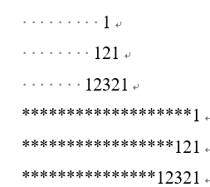
String formatting (2)
[Example 4.21] String Example (string.py):
Formatting the output string to stack triangles
print("1".center(20)) #1 line of 20 characters, center aligned
print(format("121", "^20")) #1 line of 20 characters, center-aligned
print(format("12321", "^20")) #1 line of 20 characters, center-aligned
print("1".rjust(20, "*")) #1 line of 20 characters, right-justified, with * sign
print(format("121", "*>20")) #1 line of 20 characters, right-justified, with * sign
print(format("12321", "*>20")) #1 line of 20 characters, right-justified, with a * sign

Slide 41
String formatting (3)
1. Form of the % operator
Syntax of format descriptors
format str % (value1, value2, …) # Not recommend, compatible with python2 format
>>> 'Result: %f' % 88 # Output: 'Result: 88.000000'
>>> 'Name: %s, Age: %d, Weight: %3.2f' % ('Zhang San', 20, 53)
'Name: Zhang San, Age: 20, Weight: 53.00'
>>> '%(lang)s has %(num)03d quote types.' % {'lang':'Python', 'num': 2}
'Python has 002 quote types.'
>>> '%0*. *f' % (10, 5, 88) #Output: '0088.00000'
'0088.00000'

Slide 42

String formatting (4)
2. format built-in functions
Format Specifier (format_spec) Basic Format
where fill (optional) is the fill character, which can be any character except {}; align is the alignment, including: "<" (left-aligned), ">" (right-aligned), "=" (the fill is located between the symbol and the number, e.g., '+000000120'), and "^" (centered); sign (optional) is the sign character, including: '+' (positive number), '-' (negative number), " " (positive number with space, negative number with -); '#' (optional) uses another character; '#' (optional) uses another character; '#' (positive number with space, negative number with -); '#' (optional) uses another character; '#' (optional) uses another character; '#' (optional) uses another character; '#' (optional) uses another character. " (positive), "-" (negative), " " (positive with space, negative with -); '#' (optional) uses another conversion method; '0' (optional) the left side of the numeric type formatting result is filled with zeros; width (optional) is the minimum width; precision (optional) is the precision; type is the type character of formatting.

Slide 43
String formatting (5)
Format Specifier (format_spec) Basic Format
where fill (optional) is the fill character, which can be any character except {}; align is the alignment, including: "<" (left-aligned), ">" (right-aligned), "=" (the fill is located between the symbol and the number, e.g., '+000000120'), and "^" (centered); sign (optional) is the sign character, including: '+' (positive number), '-' (negative number), " " (positive number with space, negative number with -); '#' (optional) uses another character; '#' (optional) uses another character; '#' (positive number with space, negative number with -); '#' (optional) uses another character; '#' (optional) uses another character; '#' (optional) uses another character; '#' (optional) uses another character. " (positive), "-" (negative), " " (positive with space, negative with -); '#' (optional) uses another conversion method; '0' (optional) the left side of the numeric type formatting result is filled with zeros; width (optional) is the minimum width; precision (optional) is the precision; type is the type character of formatting.
>>> format(81.2, "0.5f") #Output: '81.20000'
>>> format(81.2, "%") #Output: '8120.000000%'
>>> format(1000000, "_") #Output: 1_000_000'
>>> format(1024, "_b") #Output: '100_0000_0000'

Slide 44
String formatting (6)
3. String format method
Syntax of format descriptors
str.format(format str, value1, value2, …) # class method
format_str.format(value1, value2, …) # object method
format_str.format_map(mapping)
{[index and key]:format_spec
where the optional index corresponds to the location of the parameter value to be formatted and the optional key corresponds to the key of the mapping to be formatted
>>> "int: {0:d}; hex: {0:x}; oct: {0:o}; bin: {0:b}".format(100)
'int: 100; hex: 64; oct: 144; bin: 1100100'
>>> "int: {0:d}; hex: {0:#x}; oct: {0:#o}; bin: {0:#b}".format(100)
'int: 100; hex: 0x64; oct: 0o144; bin: 0b1100100'
>>> '{2}, {1}, {0}'.format('a', 'b', 'c') #Output: 'c, b, a'
'c, b, a'
>>> str.format_map('{name:s},{age:d},{weight:3.2f}', {'name':'Mary', 'age':20, 'weight':49})
'Mary, 20, 49.00'

Slide 45
f string (string interpolation)
Starting with Python version 3.6, support for formatted string variables has been added so that strings starting with f can contain variables embedded in the curly braces {}, called string variable substitution (interpolation)
>>> name = "Fred"
>>> f "He said his name is {name}." #Output: 'He said his name is Fred.'
'He said his name is Fred.'
>>> score, width, precision = 12.34567, 10, 4
>>> f "result: {score:{width}. {precision}}" #Output: 'result: 12.35'
'result: 12.35'

Slide 46
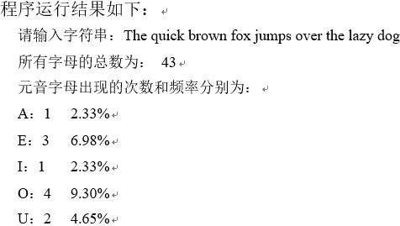
Examples of string applications (1)
[Example 5.22] String usage example 1 (str_count.py): enter any string and count the number and frequency of occurrences of the vowel letters ('a', 'e', 'i', 'o', 'u', case insensitive) in it
s1 = input('Please enter a string:') #'The quick brown fox jumps over the lazy dog'
s2 = s1.upper() #convert to uppercase
countall = len(s1) # string length
counta=s2.count('A');counte=s2.count('E');counti=s2.count('I')
counto=s2.count('O');countu=s2.count('U')
print('The total number of all letters is:', countall)
print('The number of occurrences and frequency of vowel letters are:')
print('A:{0}\t{1:2.2f}%'.format(counta, counta/countall * 100))
print('E:{0}\t{1:2.2f}%'.format(counte, counte/countall * 100))
print('I:{0}\t{1:2.2f}%'.format(counti, counti/countall * 100))
print('O:{0}\t{1:2.2f}%'.format(counto, counto/countall * 100))
print('U:{0}\t{1:2.2f}%'.format(countu, countu/countall * 100))

Slide 47
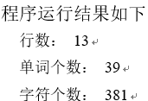
Examples of string applications (2)
[Example 5.23] String usage example 2 (txt_count.py): read a text file and count the number of lines, characters and words in it
file_name = "txt_count.py" #text file name
line_counts = 0 #line_counts
word_counts = 0 #word counts
character_counts = 0 #character_counts
with open(file_name, 'r',encoding='utf8') as f.
for line in f:
words = line.split() #separate the words
line_counts += 1 # line_counts plus 1
word_counts += len(words) #word_counts plus 1
character_counts += len(line) # character counts plus 1
print("Line counts:", line_counts)
print("Number of words: ", word_counts)
print("Number of characters:", character_counts)

Slide 48
byte sequence
Byte sequences (bytes and bytearray) are sequential data types consisting of 8 bits of byte data, i.e., a sequence of integers with 0 <= x < 256
Python's built-in byte-sequence data types include: bytes (immutable objects), bytearray (mutable objects), and memoryview

Slide 49
Bytes Constant
Use the letter b enclosed in single or double quotes
Bytes constants are defined in a similar way to strings
(1) Single quotes (b' '). A string contained within single quotes, which can contain double quotes
(2) Double quotes (b" "). A string contained within double quotes, which can contain single quotes
(3) Triple single quotes (b'''' ''''). Strings contained in triple single quotes can be spanned across lines
(4) Triple double quotes (b"""""). Strings contained within triple double quotes can be spanned across lines

Slide 50
Example 5-24: Example of bytes constants
>>> b'abc' b'abc' >>> b'abc\'x\'' b "abc'x'" >>> b'abc "x"' b'abc "x"' >>> x=b'c:\\\ Python33' >>> x b 'c:\\\ Python33' | >>> b "xyz" b'xyz' >>> b "x\tyz" b'x\tyz' >>> print(b "x\tyz") b'x\tyz' >>> print(b "x'y'z") b "x'y'z" >>> print(b "x\ny") b'x\ny' | >>> s1='''a \tb \tc \td''' >>> s1=b'''a \tb \tc \td''' >>> s1 b'a\n\tb\n\tc\n\td' | >>> s2=b"""" She said. "Yes!" """ >>> s2 b'\nShe said:\n "Yes!"\n' >>> print(s2) b'\nShe said:\n "Yes!"\n'

Slide 51
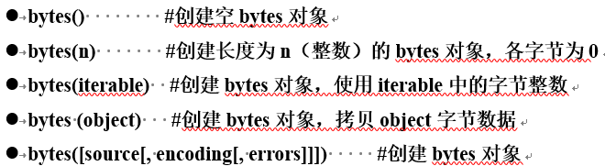
Create bytes object
# Create empty bytes object
# Create a bytes object of legnth n(int), each byte is 0
# Create a bytes object, using byte integer in iterable
# Create a bytes object, copy object byte data
# Create bytes object

Slide 52
Create bytes object
[Example 5.25] Creating a bytes object
>>> bytes() b'' >>> bytes(2) b'\x00\x00' | >>> bytes((1,2,3)) b'\x01\x02\x03' >>> bytes('abc','utf-8') b'abc' | >>> bytes((123, 456)) Traceback (most recent call last). File "<pyshell#95>", line 1, in <module> bytes((123, 456)) ValueError: bytes must be in range(0, 256)

Slide 53
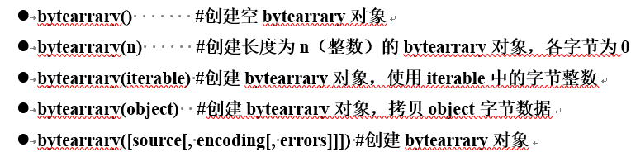
Creating bytearrary objects
[Example 5-26] Creating a bytearrary object
>>> bytearray() bytearray(b'') >>> bytearray(2) bytearray(b'\x00\x00') | >>> bytearray((1,2,3)) bytearray(b'\x01\x02\x03') >>> bytearray('abc','utf-8') bytearray(b'abc') | >>> bytearray((123,456)) Traceback (most recent call last). File "<pyshell#102>", line 1, in <module> bytearray((123,456)) ValueError: byte must be in range(0, 256)

Slide 54
Sequential operations on bytes and bytearrary
Index access, slice operations, join operations, repeat operations, membership operations, comparison operations, and finding the length of a sequence, maximum value, minimum value, etc.
The bytes and bytearrary methods do not accept string arguments, only bytes and bytearrary arguments
[Example 5-27] Example of Sequence Operation of Bytes
>>> b1=b "abc"
>>> b1.replace(b'a',b'f') #Output: b'fbc'
b'fbc'
>>> b1.replace('b','g') # TypeError: a bytes-like object is required, not 'str'

Slide 55
Byte encoding and decoding
String can be encoded as byte code by str.encode() method; decoded as string by bytes and bytearrary's decode() method
[Example 5-28] Byte Encoding and Decoding Example
>>> s='study well'
>>> b=s.encode()
>>> b
b'\xe5\xa5\xbd\xe5\xa5\xbd\xe5\xad\xa6\xe4\xb9\xa0'
>>> b.decode()
'Study hard'

Slide 56
Dictionary (mapping)
A dictionary (dict, or mapping map) is a data structure of a set of key/value pairs. Each key corresponds to a value. In a dictionary, keys cannot be repeated. Values can be queried based on keys
The hash value of the object
[Example 5.30] Example of a hash value of an object
Dictionary keys can only use immutable objects, but dictionary values can use immutable or mutable objects
>>> hash(100) #Result: 100
>>> hash(1.23) # Result: 530343892119149569
>>> hash('abc') # Result: 901130859749610928

Slide 57

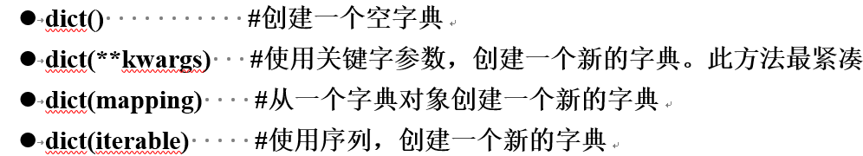
Definition of Dictionary
[Example 5.31] Creating Dictionary Objects
>>> {} {} >>> {'a':'apple','b':'boy'} {'a': 'apple', 'b': 'boy'} >>> dict() {} | >>> dict({1:'food', 2:'drink'}) {1: 'food', 2: 'drink'} >>> dict([('id','1001'),('name','Jenny')]) {'id': '1001', 'name': 'Jenny'} >>> dict(baidu='baidu.com', google='google.com') {'baidu': 'baidu.com', 'google': 'google.com'}

Slide 58
Dictionary parsing expression
Using a dictionary parsing expression, an iterable object can be processed simply and efficiently and a resulting dictionary can be generated. A dictionary parsing expression takes the following form:
{k:v for i₁ in sequence1... for i_{N} in sequenceN} #Iterate over everything in the sequence and compute the resulting dictionary
{k:v for i₁ in sequence1... for i_{N} in sequenceN if cond_expr} #Iterate by condition and compute the generated dictionary
[Example 5.32] Dictionary Parsing Expression Example
>>> {key:value for key in "ABC" for value in range(3)}
{'a': 2, 'b': 2, 'c': 2}
>>> d1={1:'food', 2:'drink', 3:'fruit'}
>>> {value:key for key,value in d1.items()}
{'food': 1, 'drink': 2, 'fruit': 3}
>>> {x:x*x for x in range(10) if x%2 == 0}
{0: 0, 2: 4, 4: 16, 6: 36, 8: 64}

Slide 59
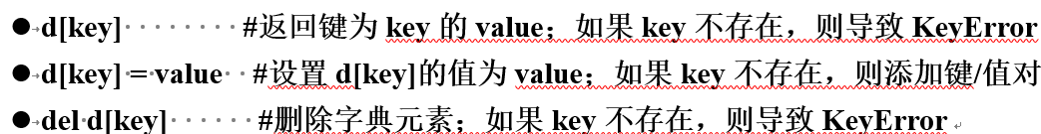
Dictionary access operations
[Example 5.33] Dictionary Access Example
>>> d={1:'food', 2:'drink'} >>> d {1: 'food', 2: 'drink'} >>> d[1] 'food' >>> d[3]='fruit' >>> d {1: 'food', 2: 'drink', 3: 'fruit'} | >>> del d[2] >>> d {1: 'food', 3: 'fruit'} >>> d[2] Traceback (most recent call last). File "<pyshell#100>", line 1, in <module> d[2] KeyError: 2

Slide 60
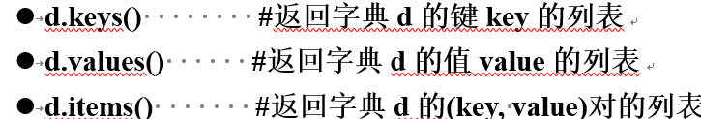
Dictionary view objects
[Example 5.34] Example of View Objects of a Dictionary
>>> d={1:'food', 2:'drink', 3:'fruit'} >>> d.keys() dict_keys([1, 2, 3]) >>> for k in d.keys():: print(k, end=" ") 1 2 3 | >>> d.values() dict_values(['food', 'drink', 'fruit']) >>> for v in d.values():: print(v, end=" ") food drink fruit | >>> d.items() dict_items([(1, 'food'), (2, 'drink'), (3, 'fruit')]) >>> for item in d.items():: print(item, end=' ') (1, 'food') (2, 'drink') (3, 'fruit')

Slide 61
Dictionary traversal
The dictionary d and its views d.items(), d.values(), and d.keys() are all iterable objects that can be iterated over using a for loop
>>> d={1:'food', 2:'drink', 3:'fruit'}
>>> for k in d:
print("key={},value={};".format(k, d[k]), end=" ")
key=1,value=food; key=2,value=drink; key=3,value=fruit.
>>> for k, v in d.items()::
print("key={},value={};".format(k, v), end=" ")
key=1,value=food; key=2,value=drink; key=3,value=fruit.
>>> for (k, v) in d.items():
print("key={},value={};".format(k, v), end=" ")
key=1,value=food; key=2,value=drink; key=3,value=fruit.

Slide 62

Determine if a dictionary key exists
[Example 5.35]: Determining if a Dictionary Key Exists
>>> d=dict(a='apple',b='boy',c='cat',d='dog') >>> d {'d': 'dog', 'a': 'apple', 'c': 'cat', 'b': 'boy'} | >>> 'a' in d True >>> 'e' not in d True

Slide 63
Dictionary object lengths and comparisons
With the built-in function len(), you can get the length of the dictionary (number of elements)
Dictionary objects also support comparison operators (<, <=, ==, ! =, >=, >), but only ==, ! == make sense.
[Example 5.36] Example of Length and Comparison of Dictionary Objects
>>> d1={1:'food', 2:'drink'} >>> d2={1:'food', 2:'drink', 3:'fruit'} >>> d3={1:'food', 2:'drink', 3:'fruit'} >>> len(d1) 2 | >>> d1 == d2 False >>> d2 ! = d3 False

Slide 64
Methods for Dictionary Objects
Assume that the examples in the table are based on d={1: 'food', 2: 'drink', 3: 'fruit'}
methodologies | clarification | typical example
d.clear() | Delete all elements | >>> d.clear();d # Result: {}
d.copy() | shallow copy dictionary (computing) | >>> d1=d.copy(); id(d), id(d1) (2487537820800, 2487537277976)
d.get(k) | Returns the value corresponding to the key k. If the key does not exist, returns None. | >>> d.get(1),d.get(5) ('food', None)
d.get(k, v) | Returns the value corresponding to key k. If key does not exist, returns v | >>> d.get(1,'none'),d.get(5,'none') ('food', 'none')
d.pop(k) | Returns the value of key k if it exists and deletes the item; otherwise causes a KeyError | >>> d.pop(1), d ('food', {2: 'drink', 3: 'fruit'})
d.pop(k, v) | If key k exists, return its value and delete the item; otherwise return v | >>> d.pop(5,'none'), d ('none', {1: 'food', 2: 'drink', 3: 'fruit'})
d.setdefault(k, v) | If key k exists, return its value; otherwise add item k= v, v defaults to None | >>> d.setdefault(1) # Result: 'food' >>> d.setdefault(4);d {1: 'food', 2: 'drink', 3: 'fruit', 4: None}
d.update([other]) | Update or add items to a dictionary using dictionaries or key-value pairsd | >>> d1={1: 'food', 4: 'books'} >>> d.update(d1);d {1: 'food', 2: 'drink', 3: 'fruit', 4: 'books'}

Slide 65

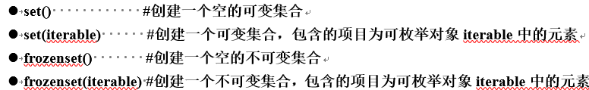
set (mathematics)
A collection datatype is an unordered aggregation of simple objects, and the elements of the collection are not duplicated
Python set data types include mutable set objects (set) and immutable set objects (frozenset)
Definition of a mutable set object (set)
{} denotes the empty dict, since dict is also defined using curly braces. The empty set is set()

Slide 66
[Example 5.37] Creating Collection Objects
>>> {1,2,1} {1, 2} >>> {1,'a',True} {1, 'a'} >>> {1.2, True} {True, 1.2} | >>> set() set() >>> frozenset() frozenset() >>> set('Hello') {'h', 'e', 'o', 'l'} | >>> {'a',[1,2]} Traceback (most recent call last). File "<pyshell#13>", line 1, in <module> {'a', [1,2]} TypeError: unhashable type: 'list'

Slide 67
Set Parsing Expressions
Using a collection parsing expression, you can simply and efficiently process an iterable object and generate a collection of results. A collection parsing expression takes the following form:
{expr for i₁ in sequence1... for i_{N} in sequence N} #Iterate over everything in the sequence and compute the resulting set
{expr for i₁ in sequence1... for i_{N} in sequenceN if cond_expr} #Iterate by condition and compute the generated set
Expression expr uses the content of each iteration i₁…i_{N}, computes and generates a collection. If the conditional expression cond_expr is specified, only the elements that satisfy the condition participate in the iteration.
[Example 5.38] Example of a Collection Parsing Expression
>>> {i for i in range(5)} # Output: {0, 1, 2, 3, 4}
{0, 1, 2, 3, 4}
>>> {2**i for i in range(5)} # Output: {1, 2, 4, 8, 16}
{1, 2, 4, 8, 16}
>>> {x**2 for x in [1, 1, 2]} #Output: {1, 4}
{1, 4}

Slide 68
Set Parsing Expressions
[Example 5.38] Example of a Collection Parsing Expression
>>> {i for i in range(5)} # Output: {0, 1, 2, 3, 4}
{0, 1, 2, 3, 4}
>>> {2**i for i in range(5)} # Output: {1, 2, 4, 8, 16}
{1, 2, 4, 8, 16}
>>> {x**2 for x in [1, 1, 2]} #Output: {1, 4}
{1, 4}

Slide 69

Determine if a collection element exists
[Example 5.39] Example of Judgment of Elements in a Set
>>> s=set('Hello') >>> s {'h', 'e', 'o', 'l'} | >>> 'h' in s False >>> 'o' not in s False

Slide 70
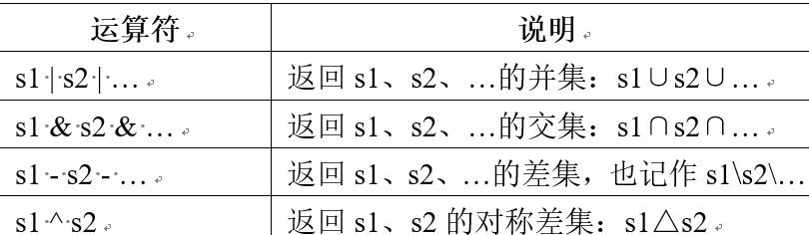
Operations on sets: union, intersection, difference and symmetric difference sets
operator | description
s1 | s2 | … | return the union set of s1, s2, … : s1∪s2∪…
s1 & s2 & … | return the intersection set of s1, s2, … : s1∩s2∩…
s1 - s2 - … | return the difference set of s1, s2, … : s1\s2\…
s1 ^ s2 | return the symmetric difference set of s1, s2, … : s1△s2

Slide 71
Operations on sets: union, intersection, difference and symmetric difference sets
method | description
s1.isdisjoint(s2) | Returns True if the sets s1 and s2 have no elements in common; otherwise returns False
s1.issubset(s2) | Returns True if the set s1 is a subset of s2; otherwise returns False.
s1.issuperset(s2) | Returns True if set s1 is a superset of s2; False otherwise.
s1.union(s2, …) | return the union set of s1, s2, … : s1∪s2∪…
s1.intersection(s2, …) | return the intersection set of s1, s2, … : s1∩s2∩…
s1.difference(s2, …) | return the difference set of s1, s2, … : s1\s2\…
s1.symmetric_difference(s2) | return the symmetric difference set of s1, s2, … : s1△s2

Slide 72
[Example 5.40] Examples of Operations on Sets
>>> s1={1,2,3} >>> s2={2,3,4} >>> s1 | s2 {1, 2, 3, 4} >>> s1 & s2 {2, 3} | >>> s1 - s2 {1} >>> s1 ^ s2 {1, 4} >>> s1.union(s2) {1, 2, 3, 4} | >>> s1.intersection(s2) {2, 3} >>> s1.difference(s2) {1} >>> s1.symmetric_difference(s2) {1, 4}

Slide 73
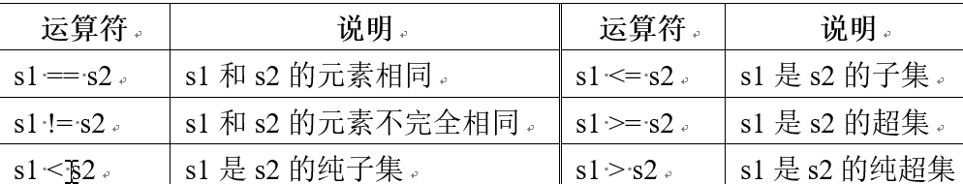
Comparison operations on sets: equality, subsets and supersets
Example 5.41: Example of Comparison of Sets
>>> s1={1,2,3} >>> s2={3,2,1} >>> s3={1,2} >>> s4={7,9} >>> s1==s2 True | >>> s1!=s4 True >>> s3<=s1 True >>> s2>s3 True | >>> s3<s4 False >>> s3>s4 False >>> s1>=s2 True | >>> s1.isdisjoint(s2) False >>> s3.issubset(s1) True >>> s2.issuperset(s3) True

Slide 74
The length of the set, the maximum value, the minimum value, the elements and the
Through the built-in functions len(), max(), min(), sum(), you can get the length of the set, the maximum value of the element, the minimum value of the element, the sum of the element
[Example 5.42] Length, Maximum Value, Minimum Value, Elements, and Examples of Sets
>>> s1={1,3,5,7,9} >>> s2={'1','2','3'} >>> len(s1) 5 | >>> max(s1) 9 >>> min(s2) '1' | >>> sum(s2) Traceback (most recent call last). File "<pyshell#16>", line 1, in <module> sum(s2) TypeError: unsupported operand type(s) for +: 'int' and 'str'

Slide 75
Methods for variable sets
Assuming that the examples in the table are based on "s1={1,2,3}; s2={2,3,4}"
methodologies | clarification | typical example
s1.update(s2, ...) s1 |= s2 | ... | union (symbol ∪) (set theory) s1= s1∪s2∪... | >>> s1.update(s2) #s1={1, 2, 3, 4}
s1.intersection_update(s2, ...) s1 &= s2 & ... | intersection (symbol ∩) (set theory) s1= s1∩s2∩... | >>> s1.intersection_update(s2) # s1={2, 3}
s1.difference_update(s2, ...) s1 -= s2 -... | difference set (math.) s1= s1-s2-... | >>> s1.difference_update(s2) # s1={1}
s1.symmetric_difference_update(s2) s1 ^= s2 | symmetric difference set (math.) s1= s1∆s2 | s1.symmetric_difference_update(s2) # s1={1, 4}
s.add(x) | Add object x to collection s | >>>s1.add('a') # s1={1, 2, 3, 'a'}
s.remove(x) | Removes object x from collection s. If it does not exist, causes a KeyError | >>> s1.remove(1) #s1={2, 3}
s.discard(x) | Remove object x from collection s (if it exists) | >>> s1.discard(3) # s1={1, 2}
s.pop() | Pop a random element from collection s. If s is empty, it causes a KeyError | >>> s1.pop() # Output: 1. s1={2, 3}
s.clear() | Empty collection s | >>> s1.clear() # s1=set()

Slide 76
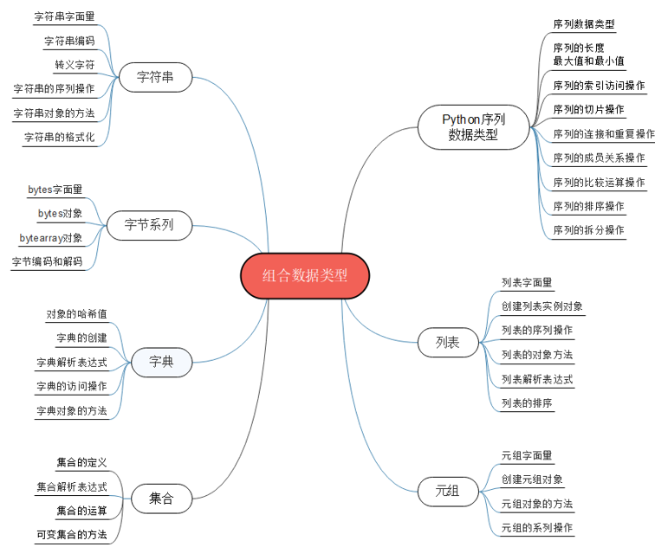
Summary of the chapter

Slide 77
Comprehensive Example 1: Simple Encryption and Decryption of Strings
The principle of the simple encryption algorithm based on per-bit logical dissimilarity is as follows:
Given a plaintext character (e.g. A) and a secret key character (e.g. P), the bitwise logical different or of its corresponding ASCII code is the encrypted ciphertext character, and the ASCII code of the ciphertext character and the ASCII code of the same secret key character are the plaintext before encryption. For example
>>> ord('A') ^ ord('P') # Output: 17
>>> chr(17 ^ ord('P')) #output: 'A'

Slide 78
Comprehensive Example 1: Simple Encryption and Decryption of Strings
Therefore, the simple string encryption algorithm and decryption algorithm based on bitwise logical differentiation can share a common function, which is designed as follows:
(1) Given the string text (e.g., The quick brown fox jumps over the lazy dog) and key (e.g., Python_1), use itertools.cycle(key) to construct a cyclic string iterator keys.
(2) Loop through each character of the text, using the corresponding character in the keys to carry out the bitwise logical different or operation, the result is the encrypted ciphertext (if decrypted, the result is the decrypted plaintext)
[Example 5.43] Simple encryption and decryption of strings (crypt.py)

Slide 79
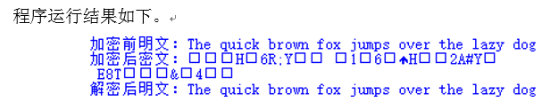
[Example 5.43] Simple encryption and decryption of strings (crypt.py)
from itertools import cycle
def crypt(text, key).
result = []
keys = cycle(key)
for ch in text:
result.append(chr(ord(ch)^ord(next(keys))))
return ''.join(result)
# Test code
if __name__=='__main__'.
plain = 'The quick brown fox jumps over the lazy dog'
key = 'Python_1'
print('Plaintext before encryption: {}'.format(plain))
encrypted = crypt(plain, key)
print('Encrypted ciphertext: {}'.format(encrypted))
decrypted = crypt(encrypted, key)
print('Decrypted plaintext: {}'.format(decrypted))

Slide 80

Application example 2: Remove duplicate items in a list
It is possible to remove duplicate items from a list by constructing a collection, but the result does not guarantee the original order
>>> a = [1, 8, 5, 1, 9, 2, 1, 10]
>>> list(set(a)) #output: [1, 2, 5, 8, 9, 10]
Removing duplicate elements from a list while maintaining the original order can be accomplished by defining a generator function
[Example 5.44] Generator function for removing duplicate items from a list (deduplicate.py)
def unique(items).
items_existed = set()
for item in items.
If item not in items_existed: if item not in items_existed.
yield item
items_existed.add(item)
if __name__ == "__main__".
# Test code
a = [1, 8, 5, 1, 9, 2, 1, 10]
a1 = unique(a)
print(list(a1))

Slide 81
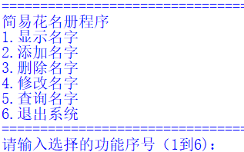
Application example 3: Simple list-based roster management system (1)
A roster management system can be easily realized through the list, which realizes the functions of displaying, querying, adding, deleting and modifying names.
[Example 5.45] Integrated Application of Lists: Simple Roster Management System (name_list.py)
def menu(): #Display the menu
print("="*35)
print("Simplified roster program")
print("1. Display name")
print("2. Add name")
print("3. Delete name")
print("4. Change name")
print("5. Query name")
print("6. Exiting the system")
print("="*35)
names = [] # Create a list object that stores the roster
while True: # Repeat

Slide 82
Application example 3: Simple list-based roster management system (2)
menu() #Display the menu
num = input("Please enter the serial number of the selected function (1 to 6):") #Get user input
# Perform the appropriate function based on the user's selection
if num == '1': #Print the list of roster lists
print(names)
elif num == '2': #add name
name = input("Please enter a name to add:")
names.append(name)
print(names)
elif num == '3': #delete the name
name = input("Please enter the name to be deleted:")
if name in names.
names.remove(name)
else.
print("Name does not exist in the system: {}".format(name))
print(names)

Slide 83
Application example 3: Simple list-based roster management system (3)
elif num == '4': #Modify name
name = input("Please enter the name to be changed:")
if name in names.
index = names.index(name)
new_name = input("Please enter the modified name:")
names[index] = new_name
else.
print("Name does not exist in the system: {}".format(name))
print(names)
elif num == '5': #query name
name = input("Please enter the name to be queried:")
if name in names.
print("Name exists in the system: {}".format(name))
else.
print("Name does not exist in the system: {}".format(name))
elif num == '6': #Exit the system
break
else: #Only the function number corresponding to an integer between 1 and 6 can be entered.
print("Wrong option, please re-select!")

Slide 84
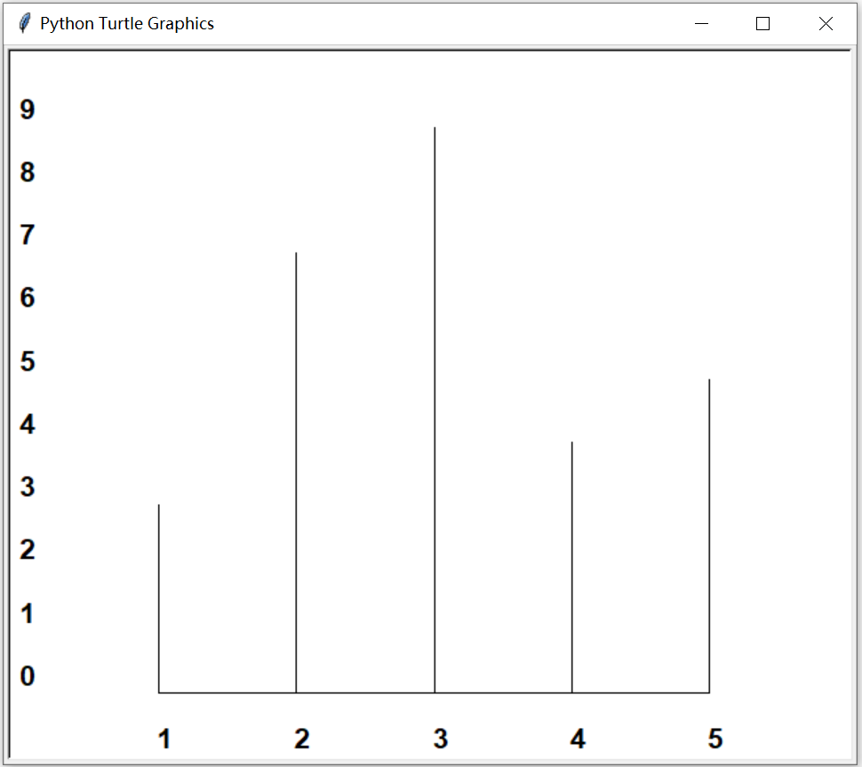
Application example 4: Frequency tables and histograms (1)
The method of constructing a frequency table can be done using a dictionary (keys are items and values are counts). Frequency tables can be easily implemented by traversing the list of data and incrementing the value of the corresponding item in the frequency dictionary.
Plotting a histogram can be done using the Turtle object described in the previous section. In the previous turtle plotting example, a turtle window is automatically created when a new turtle object is created. Using the Screen() constructor in the turtle module, it is also possible to create a separate drawing window or screen, and then add a turtle object in order to customize the drawing window by calling the method

Slide 85

Application example 4: Frequency tables and histograms (2)
Plotting a histogram can be done using the Turtle object described in the previous section. In the previous turtle plotting example, a turtle window is automatically created when a new turtle object is created. Using the Screen() constructor in the turtle module, it is also possible to create a separate drawing window or screen, and then add a turtle object in order to customize the drawing window by calling the method
[Example 5.46] Combined application of dictionaries and lists: use dictionaries to construct a frequency table for given list data, and use turtles to plot the histogram corresponding to the frequency table (freq.py)

Slide 86
Application example 4: Frequency tables and histograms (3)
import turtle #Import the turtle module
def freq_table(data_list): #count the number of values in the data_list, return a dictionary containing the count of values
countDict = {} #create a dictionary storing the frequency k: value, v: count
for item in data_list: #count the number of values in data_list
countDict[item] = countDict.get(item,0) + 1
return countDict
def draw_freq(freq_dict): #plot histogram of dictionary freq_dict with value counts
itemList = list(freq_dict.keys()) #Get the list of keys
maxItem = len(itemList) - 1 #Get the maximum number of items
itemList.sort() # sort the list of keys
countList = freq_dict.values() #Get the list of counts
maxCount = max(countList) #Get the maximum count value
# Using the Turtle object, plotting histograms
wn = turtle.Screen() #create turtle drawing window
t = turtle.Turtle() #create turtle object

Slide 87
Application example 4: Frequency tables and histograms (4)
wn.setworldcoordinates(-1, -1, maxItem + 1, maxCount + 1) #Set the drawing window size
t.hideturtle() #hide the turtle
t.up();t.goto(0, 0);t.down() #plot baseline (x-axis)
t.goto(maxItem, 0); t.up()
for i in range(0,maxCount+1): #plot y-axis labels
t.goto(-1, i)
t.write(str(i), font=("Helvetica", 16, "bold"))
for index in range(len(itemList))::
t.goto(index, -1) #draw labels
t.write(str(itemList[index]),font=("Helvetica",16, "bold"))
t.goto(index, 0) #draw count lines (height)
t.down()
t.goto(index, freq_dict[itemList[index]])
t.up()
wn.exitonclick() # close the drawing window with a single mouse click
data = [3,1,2,1,3,1,2,2,3,5,3,5,4,5,3,4,5,2,3,2,2,3,4,2,5,4,3]
freq_dict = freq_table(data) #return frequency dictionary
# Print results
itemList = list(freq_dict.keys()) #Get the list of keys
itemList.sort() # sort the list of keys
print("value", "count")
for item in itemList: #Print frequency value and count
print(item, " ", freq_dict[item])
draw_freq(freq_dict) #draw the histogram corresponding to the frequency table

Slide 88
Case Study: Guess the Word Game
The "word guessing game" uses tuples or lists to build a list of English words to be guessed, and uses the random module's choice function to randomly select an English word from the tuple of words, and then jumble the letters of the word (by randomly selecting one character at a time and placing it into the jumbled string and removing it from the original word). into the jumbled jumble string and removing that character from the original word)
The game starts by displaying the jumbled string jumble and prompting the user to enter a guess; if it is wrong, the user is prompted to continue until it is correct. If the guess is wrong, the user is prompted to continue until the guess is correct. After the guess is correct, the user can be asked whether to continue the game. The game can also be interrupted by Ctrl+C.

Slide 89
Case Study: Guess the Word Game
The reader can also extend the program, e.g. to read in lists of words from a file, to keep track of the scores of the players of a game, etc.
The solution and source code etc. of the case studies are provided in electronic format, please scan the QR code in the tutorial for details

Slide 90
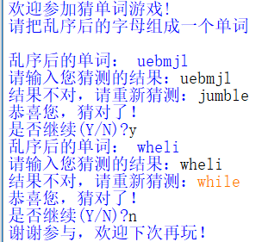
[Example CS5.1] Guess the Word Game Sample Program (word_jumble.py)

Slide 91
Thank!

